Slide 2
Unit
9
FESTIVALS AROUND THE WORLD
LESSON 2: A CLOSER LOOK 1
VOCABULARY
PRONUNCIATION
Unit
HOBBIES

Slide 3
OBJECTIVES
By the end of the lesson, students will be able to gain:
1. Knowledge:
- Vocabulary: types of festivals and festival activities.
- Pronunciation: pronounce two-syllable words with correct stress.
2. Core competence
- Develop communication skills and creativity
- Be collaborative and supportive in pairwork and teamwork
- Actively join in class activities
3. Personal qualities
- Develop self-study skills

Slide 4
LESSON 2: A CLOSER LOOK 1
WARM-UP
Game: Hot seat
VOCABULARY
Vocabulary
Task 1: Write under each picture a festival name from the box.
Task 2 Complete the table below with the phrases from the box.
Task 3: Fill in each blank with a word or phrase from the box.
PRONUNCIATION
Pronunciation
Task 4: Listen and repeat. Then underline the stressed syllable in each word.
Task 5: Listen and repeat the sentences. Underline the stressed syllables in the bold words.
PRODUCTION
Game: Up and down
CONSOLIDATION
Wrap-up
Home work

Slide 5
LESSON 2: A CLOSER LOOK 1
WARM-UP
Game: Hot seat
Aims of the stage:
To activate students’ knowledge.
Notes:
Teacher divides the class into 2 teams. Each team will send a leader to play the game on the board.
Teacher explains the instructions of the game:
Each leader stands against the board.
Teacher shows/ writes the names of the festivals (exercise 5 – page 93).
Other members from each team describe the festivals and let the leader guess the names of the festivals.
The team with more correct answers is the winner.

Slide 6
WARM-UP
La Tomatina

Slide 7
WARM-UP
Christmas

Slide 8
WARM-UP
Mid-Autumn Festival

Slide 9
WARM-UP
Cheese rolling

Slide 10
WARM-UP
Tet

Slide 11
LESSON 2: A CLOSER LOOK 1
WARM-UP
Game: Hot seat
VOCABULARY
Vocabulary
Task 1: Write under each picture a festival name from the box.
Task 2 Complete the table below with the phrases from the box.
Task 3: Fill in each blank with a word or phrase from the box.

Slide 12
PRESENTATION
Cannes Film Festival
/kæn fɪlm fes.tɪ.vl/
Liên hoan phim Cannes

Slide 13
PRESENTATION
Thanksgiving
/ˌθæŋksˈɡɪv.ɪŋ/
Lễ Tạ ơn

Slide 14
PRESENTATION
Easter (n)
/ˈiː.stər/
Lễ Phục sinh

Slide 15
PRESENTATION
carve (v)
/kɑːv/
chạm, khắc

Slide 16
PRESENTATION
perform (v)
/pəˈfɔːm/
biểu diễn

Slide 17
PRESENTATION
Form | Pronunciation | Meaning
1. Cannes Film Festival | /kæn fɪlm fes.tɪ.vl/ | Liên hoan phim Cannes
2. Thanksgiving (n) | /ˌθæŋksˈɡɪv.ɪŋ/ | Lễ Tạ ơn
3. Easter (n) | /ˈiː.stər/ | Lễ Phục sinh
4. carve (v) | /kɑːv/ | chạm, khắc
5. perform (v) | /pəˈfɔːm/ | biểu diễn

Slide 18
VOCABULARY
1
Write under each picture a festival name from the box.
Cannes Film Festival Mid-Autumn Festival Thanksgiving Christmas Halloween Easter
1. ___________
2. ___________
3. ___________
Halloween
Christmas
Mid-Autumn Festival
4. ___________
5. _________________
6. ___________
Cannes Film Festival
Easter
Thanksgiving

Slide 19
VOCABULARY
2
Complete the table below with the phrases from the box.
having a feast moon cakes chocolate eggs candy apples turkey painting eggs carving pumpkins performing a lion dance
Festival | Food | Activity
Easter
Halloween
Mid-Autumn Festival
Thanksgiving
chocolate eggs
painting eggs
candy apples
carving pumpkins
moon cakes
performing a lion dance
turkey
having a feast

Slide 20
VOCABULARY
3
Fill in blank with a word/phrase from the box.
painting eggs Christmas Mid-Autumn Festival candy apples Cannes Film Festival turkey
At ______________, people give gifts to each other.
My children love ______________ at Easter.
How many ______________ do you need for the Halloween party?
At the _________________, there are many interesting films.
Performing lion dances is one of the activities at the _________________.
Bill’s mum is cooking a ______________ for Thanksgiving.
Christmas
painting eggs
candy apples
Cannes Film Festival
Mid-Autumn Festival
turkey

Slide 21
LESSON 2: A CLOSER LOOK 1
WARM-UP
Game: Hot seat
VOCABULARY
Vocabulary
Task 1: Write under each picture a festival name from the box.
Task 2 Complete the table below with the phrases from the box.
Task 3: Fill in each blank with a word or phrase from the box.
PRONUNCIATION
Pronunciation
Task 4: Listen and repeat. Then underline the stressed syllable in each word.
Task 5: Listen and repeat the sentences. Underline the stressed syllables in the bold words.

Slide 22
PRONUNCIATION
Stress in two-syllable words
Aims of the stage:
To let students identify how to pronounce two-syllable words with correct stress
To let students practice pronouncing two-syllable words with correct stress in sentences

Slide 23
PRONUNCIATION
4
Listen and repeat. Then underline the stressed syllable in each word.
Nouns and Adjectives | Verbs
costume fireworks turkey happy | enjoy decide discuss prepare

Slide 24
PRONUNCIATION
5
Listen and repeat the sentences. Underline the stressed syllables in the bold words.
We’re going to attend an Easter party at Nick’s house.
The dancers will perform traditional dances at the festival.
At Christmas, people usually buy presents for their family.
Did you go to the Da Lat Flower Festival with your parents?
My aunt is clever and patient.

Slide 25
LESSON 2: A CLOSER LOOK 1
WARM-UP
Game: Hot seat
VOCABULARY
Vocabulary
Task 1: Write under each picture a festival name from the box.
Task 2 Complete the table below with the phrases from the box.
Task 3: Fill in each blank with a word or phrase from the box.
PRONUNCIATION
Pronunciation
Task 4: Listen and repeat. Then underline the stressed syllable in each word.
Task 5: Listen and repeat the sentences. Underline the stressed syllables in the bold words.
PRODUCTION
Game: Up and down

Slide 26
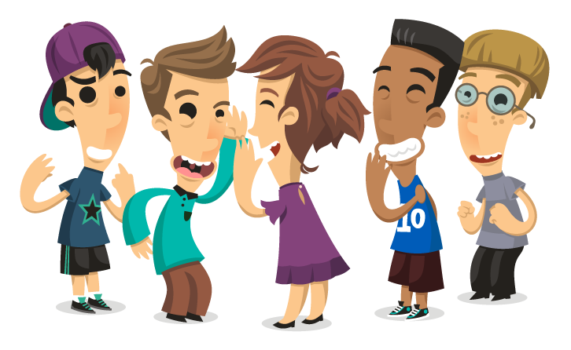
PRODUCTION
Game: Up and down
Aims of the stage:
To test students' quick reaction.
Notes:
Teacher says 1-15 words containing two-syllable words. Students stand up for the ones with first main stress pattern, sit down for the second main stress pattern.

Slide 27
LESSON 2: A CLOSER LOOK 1
WARM-UP
Game: Hot seat
VOCABULARY
Vocabulary
Task 1: Write under each picture a festival name from the box.
Task 2 Complete the table below with the phrases from the box.
Task 3: Fill in each blank with a word or phrase from the box.
PRONUNCIATION
Pronunciation
Task 4: Listen and repeat. Then underline the stressed syllable in each word.
Task 5: Listen and repeat the sentences. Underline the stressed syllables in the bold words.
PRODUCTION
Game: Up and down
CONSOLIDATION
Wrap-up
Home work

Slide 28
CONSOLIDATION
1
WRAP-UP
VOCABULARY
PRONUNCIATION

Slide 29
CONSOLIDATION
2
HOMEWORK
Do exercises in workbook

